Slide 1
PID Training
Hygieneering, Inc.

Slide 2
Photoionization Detectors

Slide 3
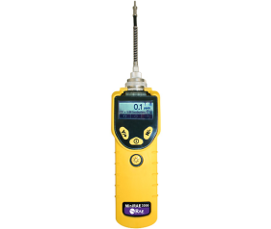
What is a PID
Very sensitive broad-spectrum monitor
Measures volatile organic compounds and other toxic gases
Similar to a low-level LEL monitor
MiniRAE 3000

Slide 4
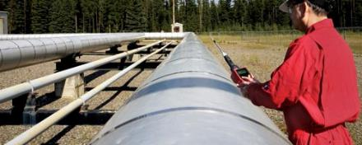
Understanding PIDs
PIDs are one of many direct-reading instruments for gases and vapors
One instrument alone is not able to measure for all contaminants in air
Instruments used for gases and vapors cannot be used for aerosols, and vice versa

Slide 5
Provides Monitoring for Numerous Scenarios
LEL Measurements
HazMat – Hazardous Materials Response
Heat Transfer Fluids
Industrial Hygiene – Assist in determining chemical exposure
Indoor Air Quality
Environmental – Residual soil, air, or water contamination
Safety – Confined Space Entry
Maintenance – Leak detection and fugitive emissions monitoring

Slide 6
What does a PID Measure?
A PID measures a group of compounds referred to as Organics, or compounds containing Carbon
Aromatics
Ketones and aldehydes
Amines and amides
Chlorinated hydrocarbons
Sulfur compounds
Unsaturated hydrocarbons, alcohols, and saturated hydrocarbons

Slide 7
What does a PID Measure? (cont.)
PIDs can also measure some inorganic compounds
Ammonia
Hydrogen sulfide
Nitric oxide
Bromine
Iodine

Slide 8
Substances that PIDs DO NOT MEASURE
Radiation
Air (N2, O2, CO2, H2O)
Toxics (CO, HCN, SO2)
Short Chain Saturated Hydrocarbons (Methane, Ethane, Propane)
Acids (HCl, HF, HNO3)
Others (Freons and Ozone O3)

Slide 9
How does a PID Work?
Quantitative analysis
PID uses an ultraviolet light source to break down chemicals to positive and negative ions
Compounds absorb UV light energy
UV light excites molecule and results in temporary loss of a negatively charged electron and formation of positively charged ion.

Slide 10
How does a PID Work? (cont.)
Inside PID, the charged particles produce a current
Current is directly proportional to mass and concentration
PID collects ions on electrode, current is translated into concentration which is displayed as parts per million (ppm) or even parts per billion (ppb)

Slide 11
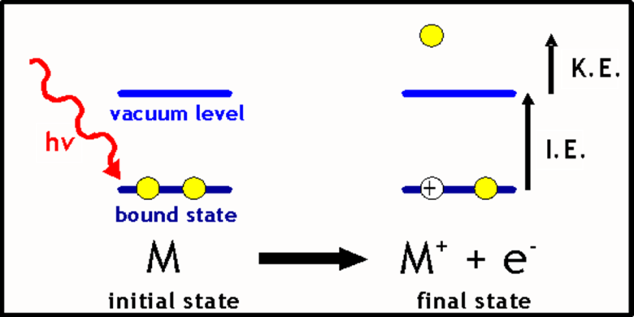
How does a PID Work? (cont.)

Slide 12
Ionization Potential (IP)
Energy required to displace an electron and “ionize” a compound is called its ionization potential
IP is measured in electron volts (eV)
All elements and chemicals can be ionized, but differ in the amount of energy they require
Light energy emitted by UV lamp is also measured in eV

Slide 13
Ionization Potential (IP)
In general, any compound with ionization energy (IE) lower than that of the lamp photons can be measured. If IE above the lamp (9.8, 10.6, 11.7), compound cannot be measured.
Example: Formaldehyde has an IE of 10.87 eV
Will not be ‘seen’ by a PID with 9.8 or 10.6 lamp
Has a Correction Factor (CF) of 1.6 with an 11.7 lamp

Slide 14
9.8, 10.6, & 11.7 eV PID Lamps
A PID uses a lamp to break down gases and vapors
If the “wattage” of a gas or vapor is less than the “wattage” of the PID lamp, then the PID can “see” the vapor
If the “wattage of the gas or vapor is greater than that of the PID lamp the PID cannot “see” the vapor

Slide 15
9.8 & 10.6 eV PID Lamps
About same lifetime and cost as CO sensor
10.6 eV lamp – most common
9.8 eV lamp – most selective
More specific than 11.7 eV lamp
Lower IP means they “see” fewer chemicals

Slide 16
11.7 eV lamp
Have shorter life than 9.8 or 10.6 lamps
Should only be used when compounds with IPs over 10.6 eV are expected
11.7 lamps have windows made of Lithium Fluoride to transmit high energy UV light
Lithium Fluoride is harder to seal to the lamp glass
Lithium Fluoride is degraded by UV light
More the instrument is used the greater the damage to the lamp

Slide 17
Selectivity and Sensitivity
PIDs are very sensitive monitors
Accurately measure gases and vapors in low ppm or ppb levels
PID is not selective, does not have the ability to differentiate between chemicals

Slide 18
Correction Factors
Also known as response factors
CFs are a measure of PID sensitivity to a particular gas
CFs permit calibration on one gas while directly reading the concentration of another
Eliminates the need for multiple calibration gases

Slide 19
Correction Factors
CFs tend to be instrument specific
Lower the CF, the more sensitive the PID is to a gas or vapor
EXAMPLE
Toluene’s CF is 0.5 – PID is very sensitive to toluene
Ammonia’s CF is 9.7 – PID is less sensitive to ammonia
Compounds with similar IPs can have very different CFs

Slide 20
Correction Factors
Example: Toluene spill; PID10.6 eV Lamp calibrated to isobutylene
PID Reading is 400 ppm
Toluene CF = 0.5 (CF=Actual/Reading)
0.5 = Actual/400 ppm
Actual Toluene Concentration is 200 ppm
OSHA PEL 200
ACGIH TLV 20

Slide 21
Calibration
What is a calibration?
A full calibration is the adjustment of the sensor(s) response to match the desired value compared to a known traceable concentration of test gas.
Before and after each day’s use for critical situations
Monthly for standard IAQ monitoring
Isobutylene is the most common calibration gas
During use if any question of accuracy
If it is not documented, it was not done!

Slide 22
Why Calibrate to Isobutylene?
Isobutylene is used because its responsiveness is about the midpoint in the range of sensitivity of PIDs
Non-toxic and non-flammable at low concentrations when used for calibration
PIDs typically calibrated with isobutylene
Can be calibrated with any ionizable gas

Slide 23
Calibration
Fresh Air Zero
Bump Test
Functional (Bump) test only verifies that gas is getting to sensors and the alarm works.
Calibration Check
Calibration check provides verification of sensor performance in addition to alarm function.
Full Calibration
A full calibration includes adjustment to the sensor’s response (Calibration Mode of the PID).

Slide 24
Calibration
MiniRAE 3000 calibration
http://www.youtube.com/watch?v=2pGx2eL6IZ4

Slide 25
Maintenance
Most maintenance can be done in house
PID sensors, lamps, and battery are all accessible without any tools
Store PIDs under dry conditions

Slide 26
PIDs and Mixtures
Excellent initial assessment tool to detect unknown
If ratio of components is known!
Custom correction factors and exposure limits can be calculated
Create a correction factor for a mixture of chemicals
CFmix = 1/((X1/CF1)+(X2/CF2)+(X3/CF3))
X = % relative concentration
CF = correction factor for relative component

Slide 27
PID Measurement Example
What if it was a solvent with 60% toluene and 40% Acetone?
PID Reading is 400 ppm
Toluene CF = 0.5 and (ACGIH TLV 20)
Acetone CF = 1.1 and (ACGIH TLV 500)
Need to calculate the correction factor for the mixture and for the exposure limit of the mixture.

Slide 28
Correction Factor of Mixture

Slide 29
Evaluation of Data

Slide 30
Exposure Limit of Mixture

Slide 31
PIDs in Humidity
Causes underreported readings (Quenching Effect)
H2O stops UV light and/or “traps” ions
False positives
Humidity may cause false positives by short circuiting sensor electrodes
Remedies
Add humidity to calibration gas

